Slide 1

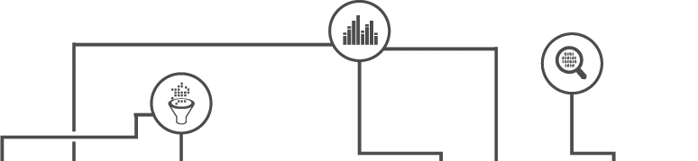

Towards Automatic Context Inference
for Sensors in Commercial Buildings

Slide 2






Notes:
People spend 93% of time indoors and providing a comfortable env can improve 8-11% productivity.
To ensure\\ that these buildings operate normally and are comfortable throughout diff weather conditions,
we need to assess and control various factors\\, such as air circulation, heat flow, moist. lv, or lgt cond.
To this end, 1000s of sensors are installed to monitor the pressure in every duct, status of every water pipe, and the kw consumption on every circuit.

Slide 3
Maintenance
Comfort
Correctness
Zone Temp 2 RMI204
Temp Floor 1 Area1
SODA1R300__ART
SODA1R410B_ART
Notes:
On top of these sensors, nuanced intelligent analytics are running continuously\\
in order to optimize the comfort\\ assure the correctness\\ identify faulty and dysfunctional equip.
As an example, an analytics that detects overheated rooms would need to locate and pull data from the tmp & tmp stpt in each room.
Contextual information about the type and location of sensors is usually extracted from the so-called point names, e.g., right bttm in bldg1: see certain structure and volcab\\ another two look completely diff\\
in other words, diff buildings use diff vocabularies and conventions for the pt names

Slide 4
Maintenance
Comfort
Correctness
Maintenance
Comfort
Correctness
Metadata Mapping
Zone Temp 2 RMI204
Temp Floor 1 Area1
SODA1R300__ART
SODA1R410B_ART
Notes:
Consequently, as a first step in running analytics, we need to create\\ a match btw the data streams and the inputs of AE\\
This process is called metadata mapping and is currently a manual process performed on a per building basis

Slide 5



SODA1R300__ART
Bldg: xxx
Zone: xxx
Room: xxx
Type: xxx
SOD
1
300
Room Temperature
Notes:
As an example, here is the pn for a tmp|| to extract the info\\ a technician with domain knowledge\\ needs to manually segment the pt names and decode\\ the information, e.g.
It takes weeks for a typical bldg with thousands of sensors&pts|| not scalable to the Ms of bldgs
besides, mapping one bldg could be 1M business\\, and this cost eats into the potential savings.

Slide 6





AHU
?
?
?
VAV
?
?
lux
AHU: Air Handling Unit
VAV: Variable Air Volume
Notes:
We want to predict types\\, based on that we also need to know the relations between points\\
e.g., there are a handful of ahus, where each h/c air and cirs to dozens of vavs, and the vav further fine tunes the air to a space. one type of important relation is the functional connection btw ahu & vav\\, which we want to idtfy by fan&flow - issue in a vav, track down ahu\\,
or co-located sensors to assess if a room is comfortable.\\

Slide 7
Sensor context can be inferred using names and data with minimal manual effort compared to existing solutions
Hypothesis
Notes:
baseline?

Slide 8
Technical Challenges
Automatic type inference
Leverage existing building(s) while no two buildings are identical
Automatic relation inference
Huge search space for possible pairwise relations

Slide 9
Thesis Contributions
Automatic type inference
Automatic relation inference
Functional connection between equipment
Co-location
Toolkit for mapping to a uniform format (Brick schema)

Slide 10
Automatic type inference
Automatic relation inference
Functional connection between equipment
Co-location
Toolkit for mapping to a uniform format (Brick schema)

Slide 11













1
SODA-ZONE2ART
SODA2R214_ART
SODA1R300_ART
Zone1 Temp RMI328
Space RMI530 TMP
DA Humiditydac4UIP17
SODA-AHU9-SFS
SODA3AHU7-SFS
Notes:
In a bldg., given names and data of sensors which are shown as a row, the goal is to automatically predict the type.
we usually have well mapped bldgs\\ and we want to leverage them; however, a challenge is how to transfer the info
On the one hand, pt name\\ is a good indicator of the type, but the pattern/convention does not generalize across buildings;
On the other hand, TS data\\ is more likely to be similar between buildings, e.g., rmt is 70-78 no matter in which building
so we transfer the info in mapped buildings by training a clf using data features+type labels\\ and apply the clf to the df in the new bldg to predict types

Slide 12


2
1
SODA-ZONE2ART
SODA2R214_ART
SODA1R300_ART
SODA-AHU9-SFS
SODA3AHU7-SFS
Notes:
we can train a different clf that learns a different perspective from the data features, and gives preds

Slide 13

3
1
2
SODA-ZONE2ART
SODA2R214_ART
SODA1R300_ART
SODA-AHU9-SFS
SODA3AHU7-SFS
Notes:
and similarly a third

Slide 14
1
2
3
0.67
0.33
0.67
SODA-ZONE2ART
SODA2R214_ART
SODA1R300_ART
SODA-AHU9-SFS
SODA3AHU7-SFS
Notes:
however, each clf can give a different prediction\\, e.g., || how to effectively adopt the preds?\\
people tend to name the same type of sensors similarly||, e.g., top3 & bottom2, so we look at how much each clf's preds agree with the name clusters, in order to quantify its confidence
e.g., we cluster names\\ and get 2 groups, we see that out of the 3 sensors\\, 2 are predicted as temps by clf1-- so we get 2/3 agreement and we assign 0.67\\ we do so\\ for each clf and take a weighted sum, e.g., 1st predicted as rmt\\
note, in some cases, the agreement can be too low, and we discard the predictions

Slide 15
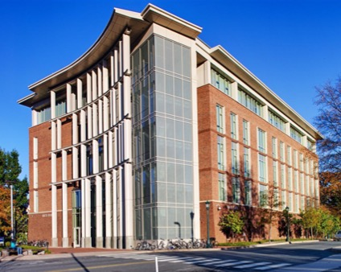
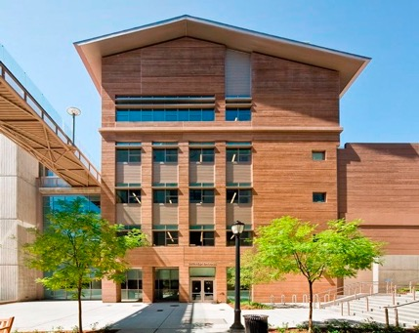
Evaluation Dataset
3 buildings on 2 campuses
2,500+ sensing and control points
22 types
A: Rice Hall
B: Soda Hall
C: Sutardja Dai Hall

Slide 16
Type Classification Accuracy by Transfer Learning
Cov: % labeled
Acc: % of labels are correct
Notes:
x-axis: threshold
metrics, two-way transfer
the way to look at this fig: 96acc/72cov 85acc/92cov
trend: in both cases, as acc goes up, cov goes down

Slide 17
Related Work
Schumann et al. - BuildSys’14
Bhattacharya et al. - BuildSys’15
Balaji et al. - BuildSys’15
Gao et al. - BuildSys’15
Koh et al. - BuildSys’18
-Still require manual effort
-Work within a building

Slide 18
Automatic type inference
Automatic relation inference
Functional connection between equipment
Co-location
Toolkit for mapping to a uniform format (Brick schema)

Slide 19
AHU
VAV
lux
Notes:
all this info now manual and auto is challenging: search space is huge considering possible #pairwise relations
Key: as they are connected, exposed to same events (fan, person), we would observe correlated events

Slide 20

AHU
VAV
Notes:
As an example, the fan speed of an AHU in blk, and the airflow in a connected VAV in red.
We see when fan changes\\, we also observe corresponding changes in vav
How do we detect the events?

Slide 21
Outlier Detection?
Notes:
OD will get the big one\\, many others look like no-event\\
if we tune the parameter to get 2nd, we will obtain many FPs.

Slide 22
Edge Detection?

Slide 23
Kinematics?
Steady
Gradual
Drastic
Notes:
We consider the kinematic state of data: steady vs dynamic
\\e.g., the orange is steady\\blue gradual\\green drastic
%We model the state in data and consider the changes in state as events
The basic idea is to estimate the state of each reading || and the state determines how the data progresses over time, in terms of velocity and noise lv.\\

Slide 24
Switching Kinematic Model
Markovian state sequence
z_{t}
latent states
e.g., event or steady
z_{t-1}
z_{t+1}
y_{t-1}
y_{t}
y_{t+1}
latent true values
Kinematics transitions
True value mapping
observed values
e.g., airflow readings
x_{t-1}
x_{t}
x_{t+1}
Notes:
More formally, the model is the following: vars \\top layer decides the state\\ and affects how data progress (vel, nosie) which is expressed by the 2nd layer\\ we also model the true values
what’s new here: globally learn the para\\consider both backwards and forwards info

Slide 25
Example Output
VAV
AHU 1
AHU 2
Notes:
Example output of the event model: a vav and its connected AHU, and a non-connecting AHU.
We see the top correlates better with the 2nd than the 3rd; the intuition however is to use only events caused due to the connection\\e.g., green
Besides these correlated events, VAVs are also affected by the activities in served space.

Slide 26

Sift Out Coincident Events
AHU
Correlation Before After
<top, mid>: 0.73 0.87
<top, bottom>: 0.59 0.21
VAV 1
VAV 2
Notes:
Masking to the rescue: when correlating a vav to an ahu, we only use events in the vav at T where ahu has events\\ e.g., (the pink ones)\\ essentially what this is doing is: when there is e in ahu, we want to see if there are also e in vav, coz we believe connected a-v will have coin'ed Es.
more quantitatively, masking increases the corr between connected equip
the assignment is argmax

Slide 27
Evaluation Dataset
 | A | B | C | D | E
# of VAV | 261 | 113 | 195 | 510 | 259
# of AHU | 12 | 8 | 5 | 13 | 8
# of Sensor | 2,754 | 1,318 | 2,010 | 4,811 | 2,379
Possible Search Space: 8¹¹³ ~= 10¹⁰²
Notes:
#vav per ahu vary from 5 - 20+

Slide 28
Functional Relation Accuracy
Inference Accuracy (%)
Notes:
Explain baselines\\

Slide 29
Effect of Amount of Data
Notes:
As we look for more correlated events over a longer time, the chance of correlation by chance drops.

Slide 30
AHU
VAV
lux
Notes:
The principle of looking for correlated events also applies to co-location

Slide 31


3.5
4.8
4.2
lux
lux
lux
…
RM 1
RM 2
RM 3
3.1
2.8
Objective:
Higher sum of all red edges
Notes:
We want to assign sensors into rooms, and assume one for each type. color of the sensor indicates ground truth room membership.
we randomly assign them as a starting piont.\\ coz we believe co-located exposed to same Es, the optimal assignments should have the largest intra-room corr, indicated by the red edges
So we optimize\\ for a higher sum of the red edges, and when the sum is highest, we reach a solution.
Genetic algorithm: generate candidates by swapping pairs of same type\\, e.g., \\ \\
we rank these candidates and replace the ones low on the rank with the top ones – as in natural selection – the best survive

Slide 32
3.5
4.8
4.2
lux
lux
lux
…
RM 1
RM 2
RM 3
4.8
4.2
Objective:
Higher sum of all red edges

Slide 33
Evaluation Dataset
200 streams from 50 rooms in one office building
4 types: CO2, humidity, light, temperature
One week’s data
Possible Search Space: (50!)⁴ ~= 8.5 * 10²⁵⁷

Slide 34
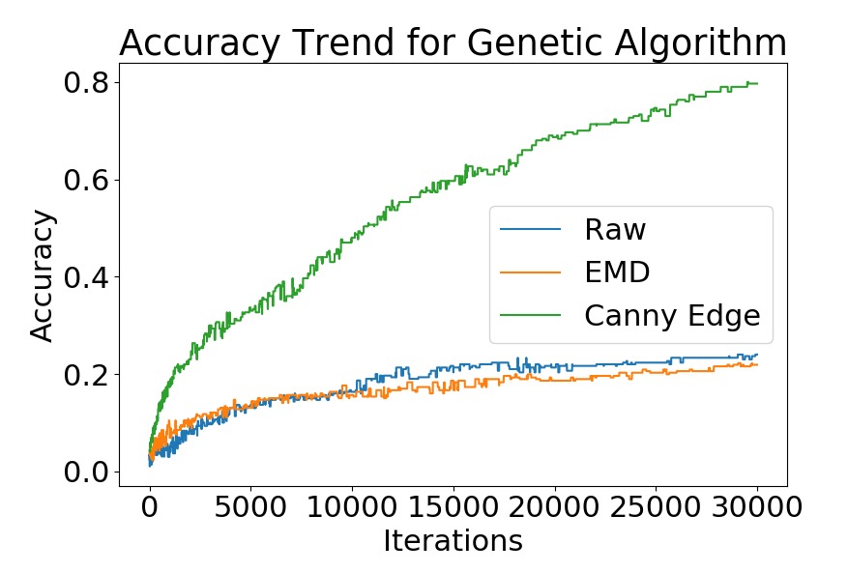
Co-location Accuracy
lux
EMD
Raw
Event
Notes:
explain baselines and axis
looking for correlated events is effective in identifying co-located sensors

Slide 35
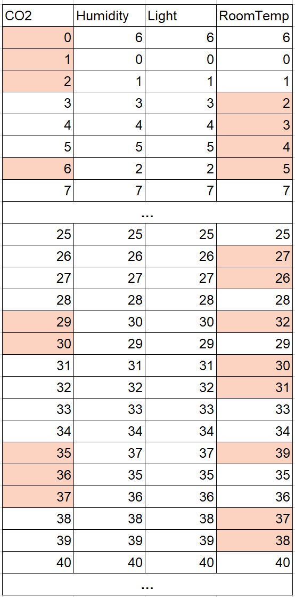
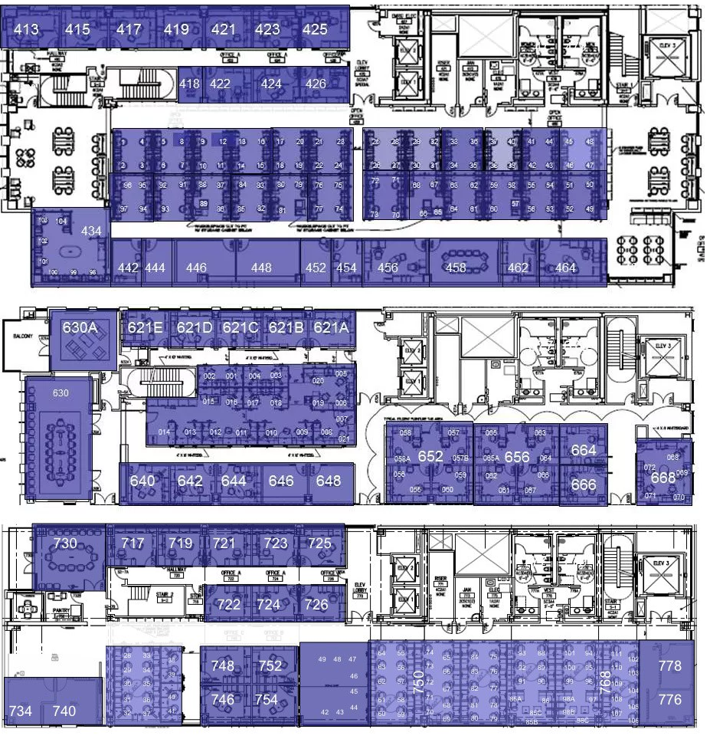
Co-location Accuracy
Notes:
Each col, each row, and order of rows (by co2)
Errors only occur in nearby rooms
Different accuracy metric ~90%

Slide 36
Related Work
Smith et al. - SigBED’12
Koc et al. - BuildSys’14
Bharttacharya et al. - BuildSys’15
Koh et al. - Arxiv’16
-Different Relations
-Require Perturbation

Slide 37
Automatic type inference
Automatic relation inference
Functional connection between equipment
Co-location
Toolkit for mapping to a uniform format (Brick schema)

Slide 38
AHU
Power Meter
Power Meter
hasPoint
AHU
feeds
Return Fan
Supply Fan
feeds
HVAC Zone
VAV
hasPart
VAV
Damper
Damper
Brick has been integrated into the ASHRAE Standard 223P for semantic tagging of building data
Notes:
After extracting the contextual information, we need to express it in a uniform format, i.e., a schema
Brick has an expressive and comprehensive vocabulary to represent the entities and their relationships\\ triplet predicate: e.g. \\ \\
it enables efficient and convenient queries.

Slide 39
Automatic type inference
Automatic relation inference
Functional connection between equipment
Co-location
Toolkit for mapping to a uniform format (Brick schema)

Slide 40
Plaster Architecture
Data Preparation
Feature Engineering
Model Training
Delivery
Building Adapter
Scrabble¹
Algorithm
Zodiac²
Prog. Synthesis³
Canonical ML
Smoothing
Data Feature Extractor
Evaluator
Utility
De-noising
Text Feature Extractor
Visualizer
Input Brickifier
Output Brickifier
¹[KBSMAG BuildSys’17] ²[BVNA BuildSys’15] ³[BHCOWW BuildSys’15]
Notes:
Plaster consists of reusable modules, and provides unified interfaces to construct algorithms and enable them to connect with each other.
e.g., BA learns type faster than zodiac

Slide 41
Workflows
Names/TS Data
De-noising
Smoothing
Building Adapter
Scrabble
Output Brickifier
from plaster.utils import DataLoader
from plaster.utils import Dataset
from plaster.utils.preprocessing import denoise, smooth
from plaster.algorithms import BuildingAdapter
from plaster.algorithms import Scrabble
from plaster.workflow import Workflow
raw_data = DataLoader(building=‘rice’)
dataset = Dataset(raw_data, type=‘time_series’, preprocessing=[denoise,smooth])
model1 = BuildingAdapter(batch_size=1, threshold=0.6, ...)
model2 = Scrabble(batch_size=10, ..)
f1 = F1(average=‘macro’)
workflow = Workflow(dataset=dataset, model=[model1,model2], metric=f1, out_format=‘brick’)
Building Adapter
Point Names
De-noising
Smoothing
Prog. Synthesis
Evaluator
Visualizer
Zodiac
TS Data
Data Feature Extractor
Random Forest
Evaluator
Notes:
Enables: workflow\\benchmark\\Feature selection

Slide 42
Thoughts…
Data “Context” will be increasingly important
In the context of
Heterogeneous sources
Repurposed data
Missing metadata
...

Slide 43















Future Work
overheated room
Notes:
prioritize attention in data, building search engine\\
create context for all personal digital traces\\
secure and protect user's data since we can infer so much info

Slide 44
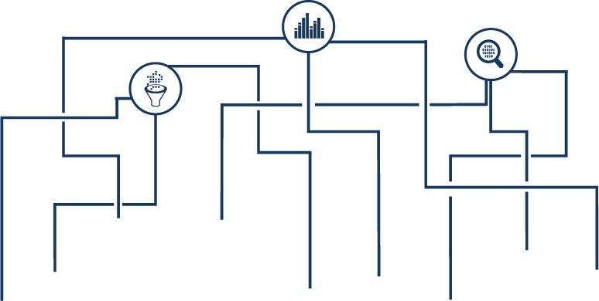


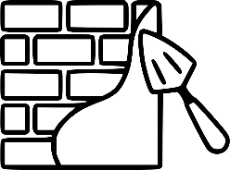
Maintenance
Comfort
Correctness
Context
Schema
Toolkit
Metadata
Mapping
Type Inference
Relation Inference
Plaster
Questions?
Notes:
ack before finish

